Slide 1

Credit Card Fraud Transaction

Slide 2
Objective:
Development of a predictive model for monitoring fraud transaction. The model will determine whether a customer is placing a fraudulent transaction or not.
Benefits:
Detection of upcoming frauds.
Gives better insight of customers base.
Helps in easy flow for managing resources.
Manual inspection if fraud is identified .

Slide 3
Data Sharing Agreement :
Length of date stamp
Length of time stamp
Number of Columns(30)
Column names
Column data type(float)

Slide 4
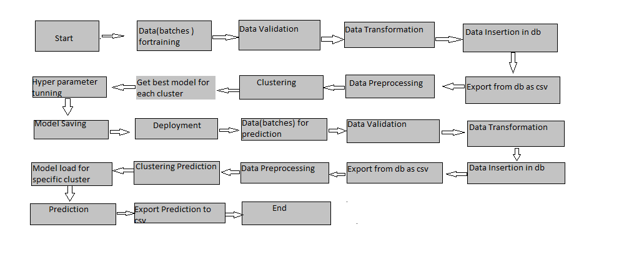
Architecture

Slide 5
Data Validation and Data Transformation :
Name Validation - Validation of files name as per the DSA. We have created a regex pattern for validation. After it checks for date format and time format if these requirements are satisfied, we move such files to “colab_file_Folder"
Number of Columns – Validation of number of columns present in the files
Name of Columns - The name of the columns is validated and should be the same as given in the schema file
Data type of columns - The data type of columns is given in the schema file. It is validated when we insert the files into Database.

Slide 6
Data Insertion in Database:
Table creation :- Table name “credit data" is created in the database for inserting the files. If the table is already present then new files are inserted in the same table.
Insertion of files in the table - All the files in the “colab files folder" are inserted in the above-created table. If any file has invalid data type in any of the columns, the file is not loaded in the table

Slide 7
Model Training:
Data Export from Db :
The accumulated data from db is exported in csv format for model training
Data Preprocessing
Performing EDA to get insight of data like identifying distribution , outliers
among data etc.
Check for null values in the columns. If present impute the null values.
Perform Standard Scalar to scale down the values.
Perform PCA .

Slide 8
Pipeline–
Created pipeline for every model
Model Selection –
After the pipelines are created, we find the best model for each cluster. By using pipeline ( algorithms “Random Forest” ,”Xgboost” etc.). For each pipeline the hyper tuned algorithms are used. We calculate the AUC scores for all pipeline models and select the model with the best score. Similarly, the model is selected for each pipeline. We select random forest with the best accuracy and did prediction.

Slide 9
Prediction:
The testing files are shared in the batches and we perform the same Validation operations ,data transformation and data insertion on them.
The accumulated data from db is exported in csv format for prediction
We perform data pre-processing techniques on it.
Random Forest model created during training is loaded and hyper tuned for the preprocessed data predicted
Based on the respective model was loaded and was used to predict the data for that model.
Once the prediction is done for all the Random Forest. The predictions are saved in csv format and shared.

Slide 10
Q & A:
Q1) What’s the source of data?
The data for training is provided by the client in multiple batches and each batch contain multiple files
Q 2) What was the type of data?
The data was the contain only of numerical values.
Q 3) What’s the complete flow you followed in this Project?
Refer slide 5th for better Understanding
Q 4) After the File validation what you do with incompatible file or files which didn’t pass the validation?
Files like these are moved to the Achieve Folder and a list of these files has been
shared with the client.

Slide 11
Q 5) How logs are managed?
We are using different logs as per the steps that we follow in validation and
modeling like File validation log , Data Insertion ,Model Training log , prediction log
etc.
Q 6) What techniques were you using for data pre-processing?
Removing unwanted attributes
Visualizing relatiaon of independent variables with each other and output variables
Checking and changing Distribution of continuous values
Removing outliers
Cleaning data and imputing if null values are present.
Scaling the data
PCA

Slide 12
Q 7) How training was done or what models were used?
Before diving the data in training and validation set we performed preprocessing and featuring scaling.
The scaling was performed over training and validation data
Algorithms like K-mean, XGBoost, Random Forest etc were used and select our final model and we saved that as Model.pkl.
Q 8) How Prediction was done?
We got test data after doing train_test_split. Then selected the beast model and loaded it after that performed prediction. At the end we got the accumulated data of predictions.

Slide 13
Q 9) What are the different stages of deployment?
When the model is ready we deploy it in Fire environment .Where SIT and UAT is performed over it.
Once We get Sign off from Fire we deploy in Earth and UAT is performed over it.
After getting the sign off from Earth we deploy in production

Slide 14
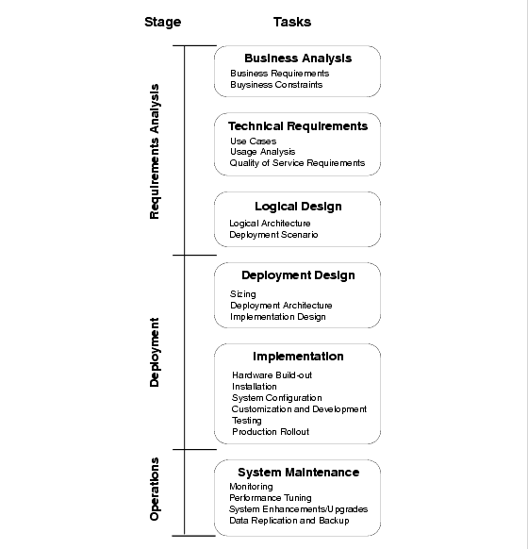

Slide 15
Special Thanks
Thanks for the guidance and support needed to build this wonderful and exciting project.Team Inueron regular assistance and support proved was significant and fruitful in the development of this project.
Mentors-:
Sudhanshu Kumar
Krish Naik
Designed by - Vishvajeet Singh

